Slide 1

AGENTIC ARTIFICAL
INTELLIGENCE
VS
GENERATIVE ARTIFICAL
INTELLIGENCE

Slide 2


Generative AI: The Content Creator
What it does
Examples
Generative AI creates content based on user input, such as text, images, or code.
ChatGPT for text, DALL·E/Midjourney for images, and GitHub Copilot for code.
How it works
Users provide a prompt, and the AI generates a response; it does not act autonomously.
Common use cases include writing essays, creating images, coding assistance, and chatbots.

Slide 3

Agentic AI: The Decision Maker
What it does
Examples
Agentic AI makes decisions and performs actions to achieve a specific goal.
AI agents that plan tasks, utilise multiple tools, and execute steps automatically.
How it works
Users provide a goal, and the AI plans the steps, uses tools, and completes the task.
Use cases include task automation, smart assistants, auto-deployment systems, and AI project management.

Slide 4

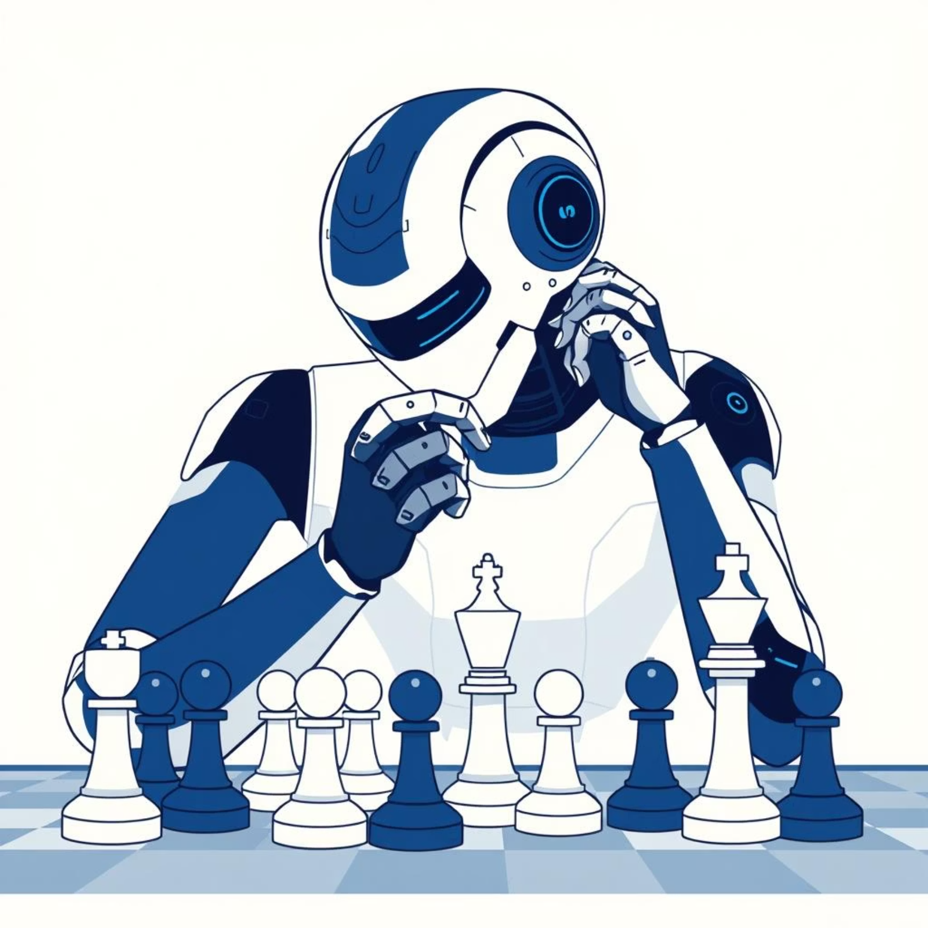
Generative vs. Agentic AI
Generative AI
Agentic AI
Focuses on creating content like text, images, or code based on user prompts. It does not initiate actions independently.
Designed to make decisions, plan steps, and take actions to achieve a given goal autonomously.
Understanding the distinction is crucial for leveraging AI effectively in various applications.

Slide 5
THANK YOU
SAAD BIN RIAZ
BAI-25F-035

